Slide 1
WEEKS 7–8
Plankton Ecology, Bioassessment & Monitoring
From phytoplankton and grazing dynamics to biotic indices, diatom archives,
and the tropical challenge for Guyanese freshwaters.
Limnology │ University of Guyana

Slide 2
DISCUSSION
I left you last week with a question: What determines whether a lake is green — full of algae — or clear?
Think about what we covered in Weeks 4 and 5 — nutrients, light, temperature, mixing. But one factor gets consistently overlooked.
Limnology │ University of Guyana

Slide 3
This Session's Roadmap
Part 1: Phytoplankton diversity and functional groups
Part 2: Zooplankton ecology and Daphnia
Part 3: Trophic cascades and the cyanobacteria–Daphnia impasse
Part 4: Why bioassess, and the reference condition approach
Part 5: Macroinvertebrate bioassessment and biotic indices
Part 6: Diatom-based assessment and transfer functions
Part 7: Emerging tools — eDNA, remote sensing, sensors
Part 8: Tropical challenge and Guyana's research opportunities
Integrates more than any session so far: Week 2 DO, Week 3 macroinvertebrates, Week 4 lake physics, Week 5 nutrients, Week 6 wetland filtering.
Limnology │ University of Guyana

Slide 4
Part 1: Phytoplankton Diversity
& Functional Groups
The invisible engine of lake ecosystems
Limnology │ University of Guyana

Slide 5
The Invisible Engine
Phytoplankton: microscopic photosynthetic organisms, <1 µm to several hundred µm
~46% of global NPP — ~48.5 of 104.9 Pg C/yr (Field et al., 1998). About half of Earth's oxygen
Chlorophyll-a is the most widely used trophic state indicator (Carlson's TSI, Week 5)
Oligotrophic <2 µg/L · Mesotrophic 2–8 µg/L · Eutrophic >8 µg/L
Composition matters as much as biomass — diatom-dominated ≠ cyanobacteria-dominated
Same chlorophyll-a · completely different ecological state · completely different management prognosis
Limnology │ University of Guyana

Slide 6
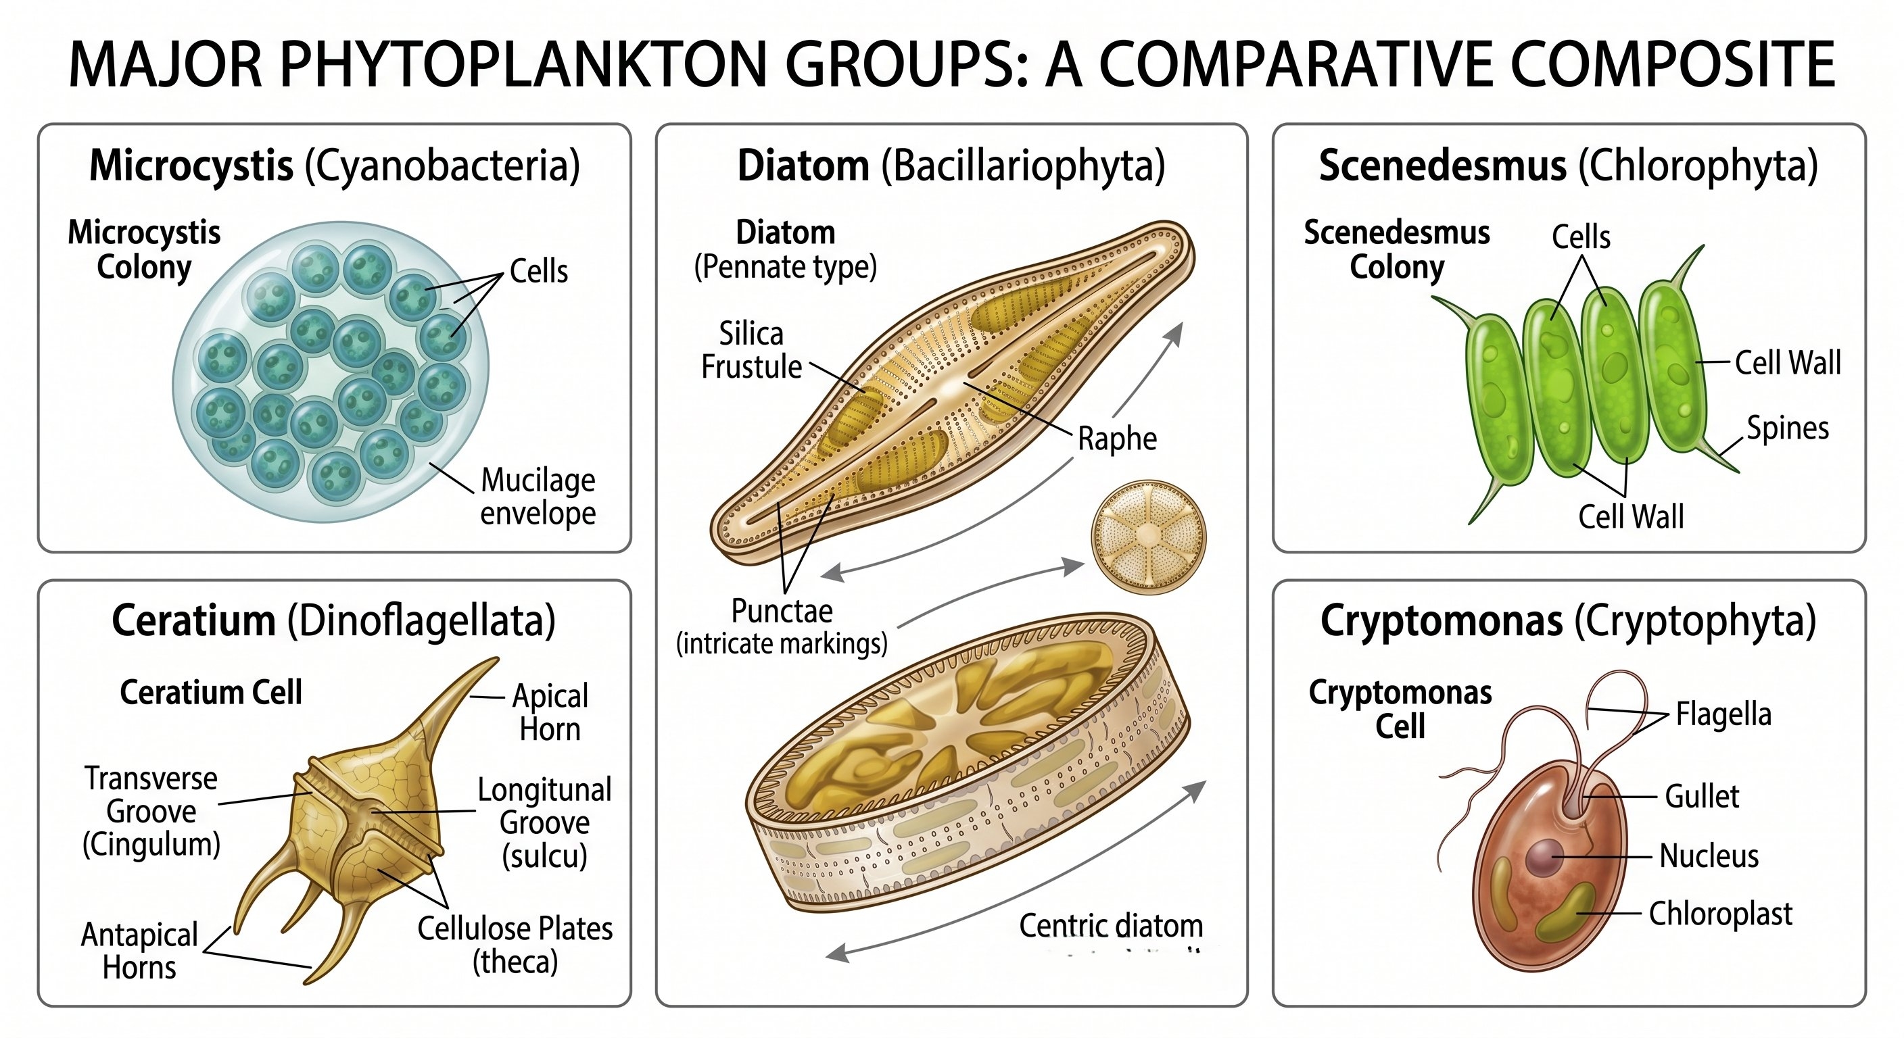
Major Freshwater Phytoplankton Groups
Cyanobacteria — prokaryotes; N₂ fixation, buoyancy regulation, microcystin toxicity
Chlorophytes (green algae) — most diverse; excellent food quality for grazers
Diatoms — silica frustules; need dissolved Si; tolerance-calibrated for bioassessment
Dinoflagellates — mixotrophic; some migrate vertically (Ceratium)
Cryptophytes — small flagellates; highly edible first responders
Cyanobacteria are terrible food — toxic, clog feeding, nutritionally deficient
Limnology │ University of Guyana

Slide 7
Reynolds' C-S-R Framework
Adapted from Grime's plant ecology (Reynolds, 1988; 2006)
C-strategists — competitive colonists; small cells, rapid nutrient exploitation (small green algae, cryptophytes)
S-strategists — stress-tolerant; large, slow-growing, often motile (many cyanobacteria, large dinoflagellates)
R-strategists — ruderal, disturbance-tolerant (filamentous diatoms like Aulacoseira)
Predictive: stratified summer → S · spring mixing → R · nutrient pulse in turbulence → C
Reynolds et al. (2002) / Padisák et al. (2009): 30+ coda (H1, Y, P, SN, Lo…) — diagnostic without full chemistry
Limnology │ University of Guyana

Slide 8
Tropical Phytoplankton — How Different?
Reynolds functional classification validated in South American lakes (Kruk et al., 2002)
Tropical floodplain succession driven by flood pulse, not thermal seasonality (Huszar & Reynolds, 1997 — Lago Batata)
Year-round warm temperatures: no winter reset, continuous growth
Functional approach works better than taxonomy for tropical–temperate comparison — same traits, different species
Guyana predictions: blackwater → chrysophytes + small flagellates; EDWC dry season → cyanobacteria; Rupununi → flood-pulse succession
All testable hypotheses; all unsampled
Limnology │ University of Guyana

Slide 9
Part 2: Zooplankton Ecology
The grazers that can clear a lake
Limnology │ University of Guyana

Slide 10
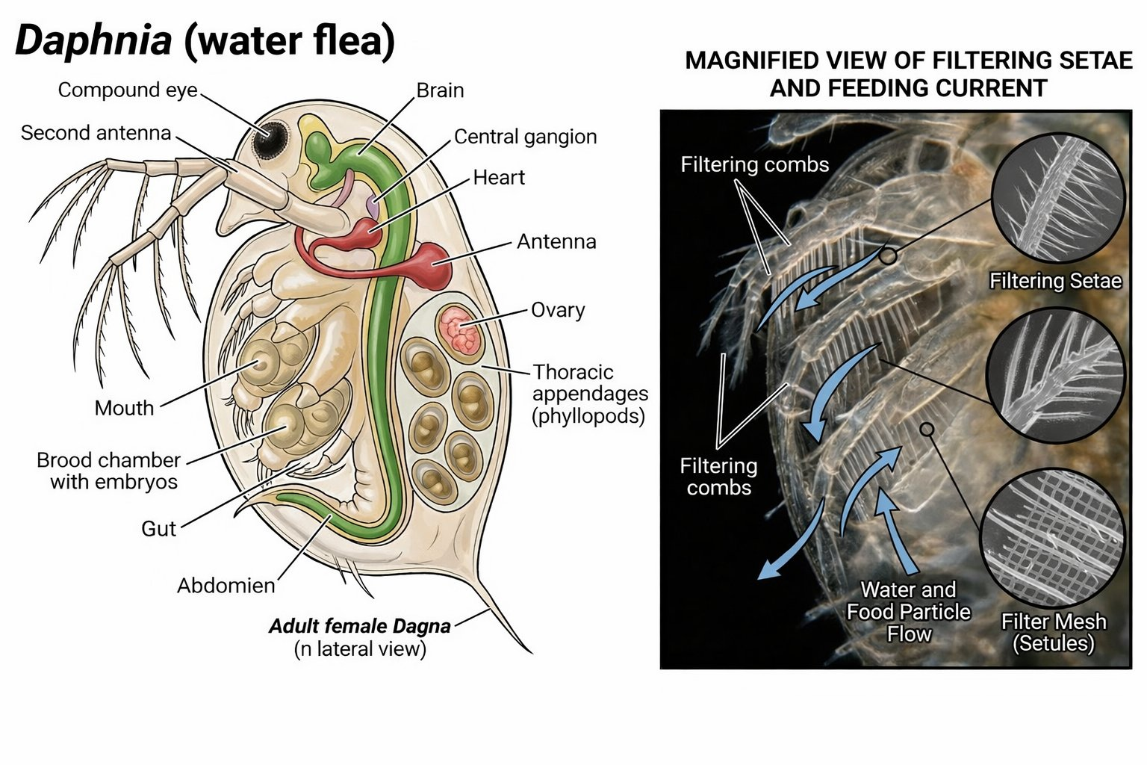
Meet Daphnia — The Keystone Grazer
Filter-feeding cladoceran: pumps water through setae mesh, straining 1–50 µm particles
Daphnia magna ~77 mL/day · Bosmina ~0.3 mL/day — a 250-fold difference* (Havens & Beaver, 2011)
Population doubling ≤3 days at ≥20°C (Ebert, 2005) — cyclical parthenogenesis
Resting eggs (ephippia) survive desiccation, freezing, fish gut passage
Diel vertical migration: descend by day (fish avoidance), ascend to feed at night
Fish predation is the dominant selective pressure in Daphnia's life
Limnology │ University of Guyana

Slide 11
The Size-Efficiency Hypothesis
Brooks & Dodson (1965, Science)* — one of the most cited papers in aquatic ecology
In the absence of fish predation, large cladocerans outcompete small ones — bigger filters, broader particle range, persist on lower food
Visually hunting planktivores selectively remove the largest individuals — bigger targets, more energy per capture
When planktivores dominate: zooplankton community shifts to Bosmina, Ceriodaphnia, small copepods — grazing capacity collapses
Two lakes, identical nutrients, different clarity → the answer is in the food web above the zooplankton
Limnology │ University of Guyana

Slide 12
DISCUSSION
THINK–PAIR–SHARE
A lake has abundant nutrients and dense planktivorous minnows. Predict: (1) dominant zooplankton, (2) phytoplankton biomass, (3) water clarity.
Now: what happens if you introduce largemouth bass?
Use Brooks–Dodson to trace the logic.
Limnology │ University of Guyana

Slide 13
Part 3: Trophic Cascades
When fish determine water clarity
Limnology │ University of Guyana

Slide 14
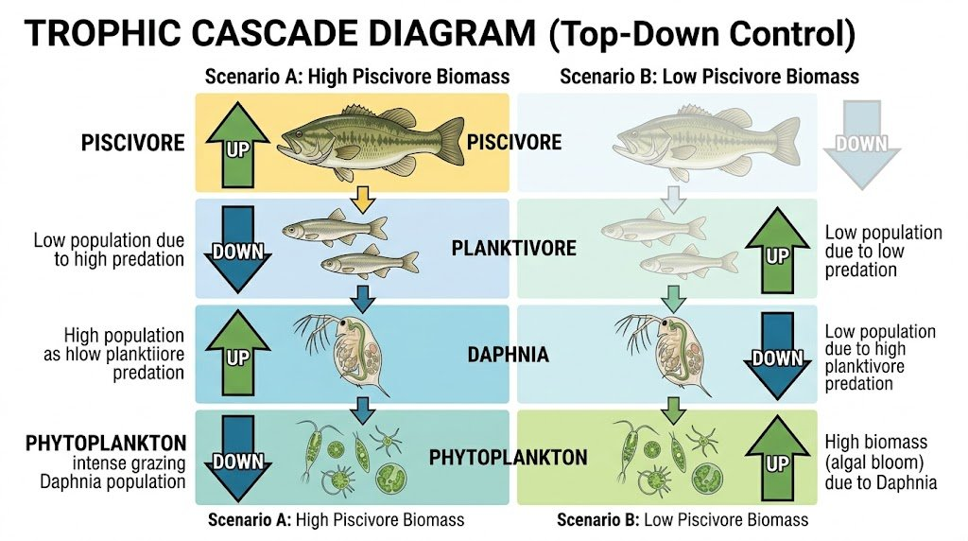
The Carpenter Cascade & Biomanipulation
Carpenter et al. (1985, BioScience) introduced the concept to limnology
Four-level cascade: piscivores ↑ → planktivores ↓ → Daphnia ↑ → phytoplankton ↓
Peter & West Long Lakes: Daphnia-dominated systems suppressed phytoplankton across nutrient gradients (Carpenter et al., 2001)
Biomanipulation (Shapiro 1975; Jeppesen 2012) — remove planktivores, stock piscivores
Danish lakes: Secchi depth <1 m → 3–4 m in one growing season; macrophytes returned
Nutrient reduction = foundation; biomanipulation = accelerant. Foundation first.
Limnology │ University of Guyana

Slide 15
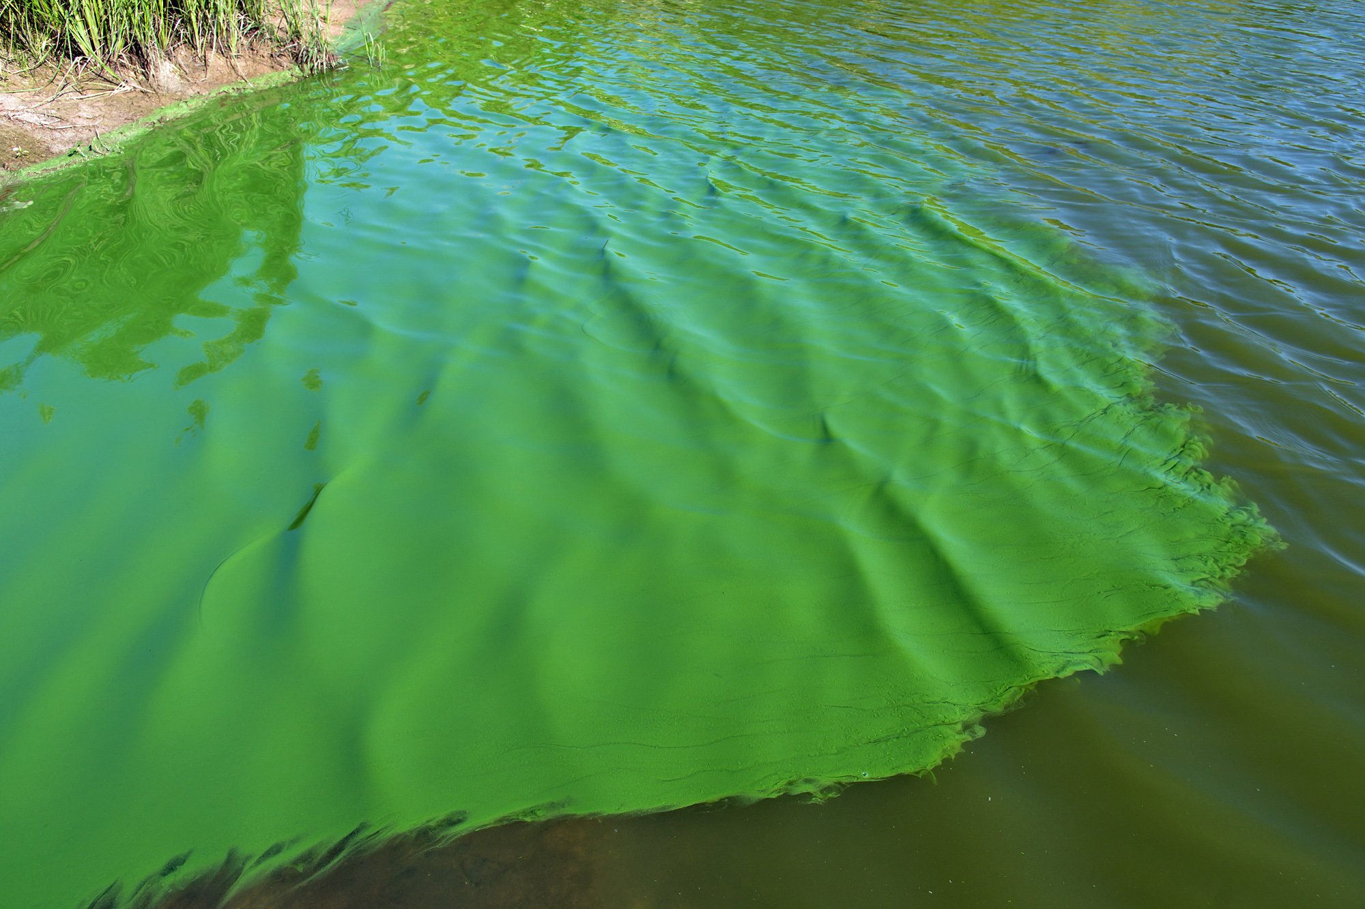
The Cyanobacteria–Daphnia Impasse
Physical interference — filaments tangle in thoracic limbs; clearance drops 50–80%. Microcystis colonies exceed ingestible size
Toxicity — microcystin inhibits protein phosphatases; chronic 1–10 µg/L depresses Daphnia population growth
Poor nutritional quality — cyanobacteria lack EPA/DHA; abundant C but nutritional junk food
Positive feedback loop: eutrophication → cyanobacterial dominance → grazing impaired → more cyanobacteria → locked turbid state
Breaking out requires nutrient reduction first, then food-web restoration
Limnology │ University of Guyana

Slide 16
Why Trophic Cascades Are Weaker in the Tropics
Jeppesen et al. (2012) — four reasons biomanipulation fails in warm lakes:
1. Fish reproduce year-round — no winter bottleneck; rapid recruitment recovery after removal
2. Piscivore guilds diverse but individually weak — no dominant top-down control
3. Omnivory — cichlids, characids, loricariids eat zooplankton and disturb sediments (release P). Worst possible combination
4. Small-bodied zooplankton dominance — Moina, Ceriodaphnia, Diaphanosoma (Gillooly & Dodson 2000; Meerhoff et al. 2012)
Subtropical mesocosms: piscivore stocking suppresses small fish but does not produce clear water (He et al., 2022)
Rupununi fish communities (450+ spp.) are nothing like Wisconsin — open research frontier
Limnology │ University of Guyana

Slide 17
Part 4: From Plankton
to Bioassessment
Why biology tells us what chemistry alone cannot
Limnology │ University of Guyana

Slide 18
Chemistry Snapshot vs. Biology Diary
Chemical monitoring = snapshot. Monthly sampling = 12 snapshots/yr; you miss 353 days of variability
Episodic pollution events (night discharge, rain-driven runoff, storm sewage) rarely coincide with grab samples
Biological monitoring = diary. Benthic organisms live at the site for weeks to months and integrate the full stressor regime (Cairns & Pratt, 1993)
Sensitive EPT absent + tolerant chironomids/oligochaetes dominant = forensic evidence of recurrent impairment
Chemistry identifies; biology confirms. Strongest programmes use both.
Limnology │ University of Guyana

Slide 19
Three Pillars & the Reference Condition Approach
Three pillars — biological indicators · habitat assessment · physicochemical monitoring
Reference condition approach — compare observed to what would be expected without disturbance
O/E ratio — values near 1.0 = taxa as expected; values <<1.0 = taxa missing
Formalised in RIVPACS (UK) and AUSRIVAS (Australia)
EU WFD (2000): five classes — High · Good · Moderate · Poor · Bad — via Ecological Quality Ratios
Guyana: no reference conditions established for any system type — cannot yet quantify impairment
Strategic advantage: intact headwaters are still available as potential reference sites
Limnology │ University of Guyana

Slide 20
Part 5: Macroinvertebrate
Bioassessment
The workhorses of stream assessment
Limnology │ University of Guyana

Slide 21
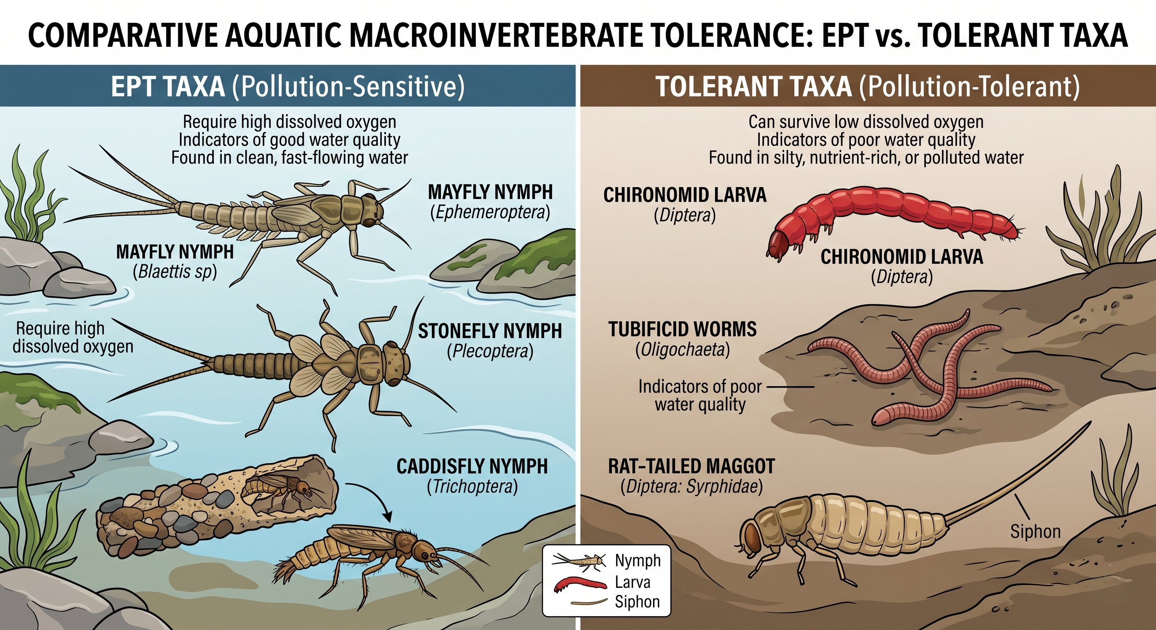
The Pollution Sensitivity Spectrum
Sensitive: EPT (Ephemeroptera, Plecoptera, Trichoptera) — need DO >7 mg/L, delicate gills
Tolerant: Chironomidae — thrive in low-O₂, organic-rich conditions
Tubificid oligochaetes — haemoglobin binds O₂ at very low concentrations
Syrphid rat-tailed maggots — siphon breathes atmospheric air in anoxic water
Absent sensitive + dominant tolerant = degradation inferred, even without knowing the specific stressor
Limnology │ University of Guyana

Slide 22
Key Biotic Indices
EPT richness — count of Ephemeroptera/Plecoptera/Trichoptera families. >15 excellent; <5 severely impaired
BMWP (Armitage et al., 1983) — family tolerance scores 1–10, summed (e.g. Heptageniidae 10; Chironomidae 2). Effort-dependent
ASPT — BMWP ÷ scoring families. >6 = Good–High · 5–6 = Moderate · <4.5 = significant organic pollution
Hilsenhoff FBI (1988) — abundance-weighted tolerance 0–10. <3.75 excellent · >7.26 very poor. Lower is better
Multimetric IBI (Karr, 1981) — composite of multiple metrics; more robust to any single-metric failure
Limnology │ University of Guyana

Slide 23
DISCUSSION
THINK–PAIR–SHARE: READING THE COMMUNITY
Same river · same geology · same climate.
Site A: 28 taxa total · 60% Chironomidae · only 3 EPT families
Site B: 12 taxa total · 15% Chironomidae · 8 of 12 families are EPT
Which site is in better ecological condition — and why?
Limnology │ University of Guyana

Slide 24
Part 6: Diatom-Based
Assessment
Nature's water quality archive
Limnology │ University of Guyana

Slide 25
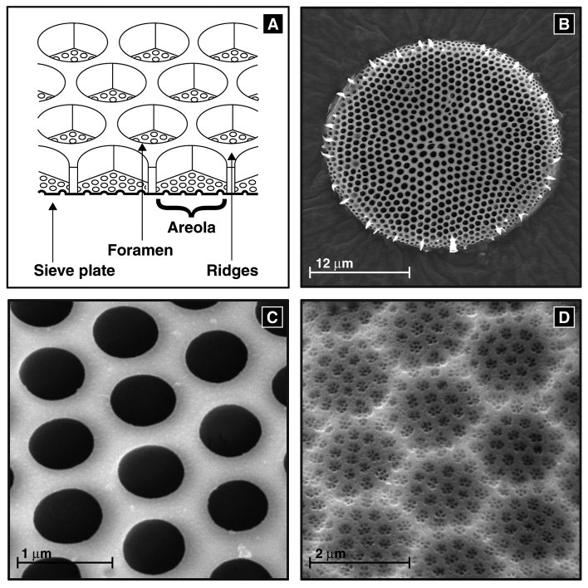
Why Diatoms Are Unique Bioindicators
Siliceous frustules preserve in sediments for millennia — glass, essentially
Species-specific environmental tolerances (pH, TP, salinity)
Rapid turnover, ubiquity, enormous diversity (100–200 spp./sample), standardised methods
Dual-use capability — living assemblages = current conditions; fossil assemblages = centuries of history
Example: Achnanthidium minutissimum = low-nutrient, well-oxygenated; Nitzschia palea + Gomphonema parvulum = organic enrichment
Standard prep: acid-clean, mount, identify 300–400 valves at 1000× oil immersion
Limnology │ University of Guyana

Slide 26
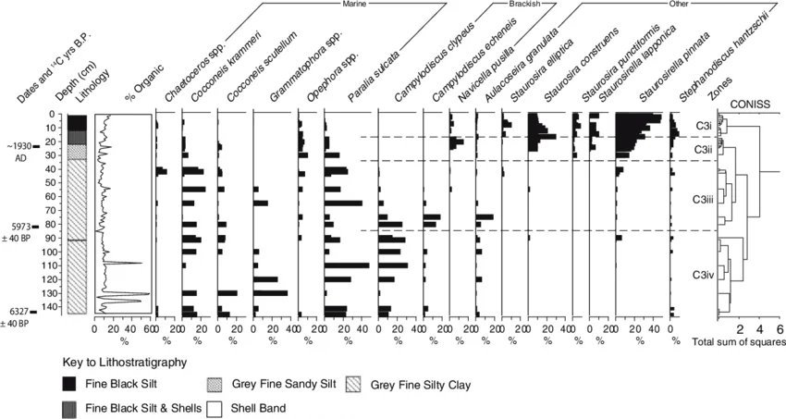
Diatom Transfer Functions
Relate modern diatom assemblages to measured environmental variables; then infer past conditions from fossil assemblages in cores (Birks et al., 1990)
Build training set: 50–150 lakes with paired diatom + chemistry data · fit weighted-averaging regression
Apply the model to fossil diatoms from a sediment core → reconstruct past TP, pH, salinity
Bennion et al. (1996): 152-lake NW Europe set; WA-PLS RMSEP = 0.21 log₁₀ TP; range 10–1000 µg/L
Cardoso-Silva et al. (2025) — works in tropical reservoirs · calibration must be regional
No diatom training set exists for the Guiana Shield — PhD-scale opportunity
Fossil diatom stratigraphy in a sediment core (illustrative)
Limnology │ University of Guyana

Slide 27
Part 7: Emerging Tools
eDNA · remote sensing · high-frequency sensors
Limnology │ University of Guyana

Slide 28
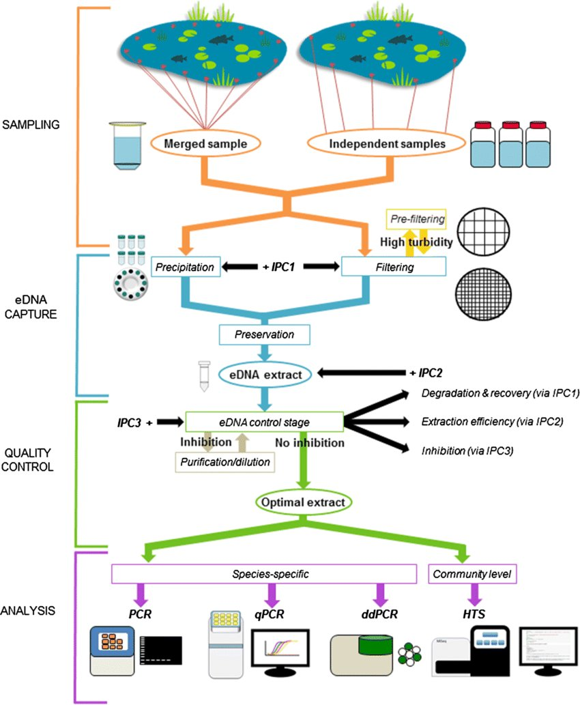
Environmental DNA
DNA shed by organisms — filter, extract, PCR, sequence, match to reference database
Species-specific (targeted primers) vs metabarcoding (universal primers, full community)
French Guiana: eDNA at 39 sites detected 132 fish species from ~17M reads — complementary to traditional methods (Cilleros et al., 2019)
Effort matters: ~34 L → 64% of expected fauna; ~170 L → ~80% (Cantera et al., 2019)
Limitations: presence/absence only · rapid degradation in warm/UV water · incomplete tropical reference DBs · downstream transport false positives
Limnology │ University of Guyana

Slide 29
Remote Sensing & Continuous Sensors
Sentinel-2 (ESA): 10-m resolution, 5-day revisit, free data, free Google Earth Engine processing
Mining turbidity mapping in the Mazaruni/Potaro needs no fieldwork — any student could start this week
Continuous multiparameter sondes (15–60 min logging) → 35,000+ points/parameter/year
High-frequency DO enables whole-system metabolism (GPP, ER) — impossible from grab sampling
For Guyana, one logger at EDWC or a mainstem Essequibo station would begin the temporal baseline that does not yet exist
Emerging tools complement — they do not replace — traditional biology + chemistry
Limnology │ University of Guyana

Slide 30
Part 8: The Tropical Challenge
& Guyana's Opportunity
Terra incognita
Limnology │ University of Guyana

Slide 31
Why Temperate Methods Don't Fully Transfer
Three systematic tropical challenges: unresolved taxonomy · uncalibrated tolerance values · missing reference conditions
Dedieu et al. (2016): indices from one neotropical region may fail in another — regional calibration essential
A Baetidae mayfly in Europe ≠ a Baetidae mayfly in Guyana (different species, different baselines)
But bioassessment does work in the tropics — Tampo et al. (2021): EPT/ASPT/BMWP robust in Togolese rivers
French Guiana (WFD): IBMG macroinvertebrate index + French Guiana Diatomic Index — the closest analogue to what Guyana would need
Limnology │ University of Guyana

Slide 32
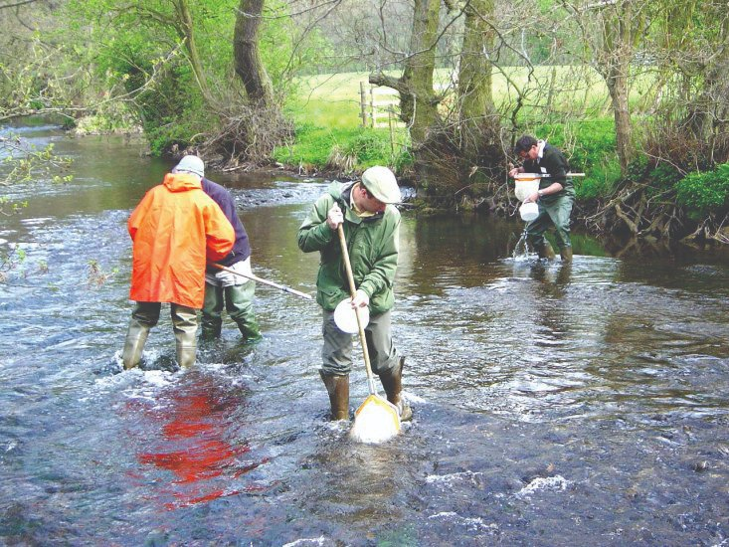
Data Voids & Research Opportunities in Guyana
~0 published phytoplankton or zooplankton data for Guyanese freshwaters
~0 macroinvertebrate tolerance values calibrated for Guiana Shield taxa
~0 diatom training sets for Guiana Shield transfer functions
North Rupununi: 22,000 ha, 750+ lakes, 450+ fish species — a plankton ecologist's dream, unsampled
EDWC: drinking-water source — phytoplankton + ELISA microcystin screening = direct public health value
Mazaruni / Potaro / Cuyuni: upstream–downstream paired sites — bridges to Week 9 (ASGM)
Every zero is a publishable first-of-kind — kick-net under US$100, microscope, plankton net, consistent sampling
Kick-net sampling — field-deployable, low-cost, effective
Limnology │ University of Guyana

Slide 33
Key Takeaways
Phytoplankton composition ≠ biomass — Reynolds functional groups predict community responses
Daphnia is the keystone grazer** — 250× filtering advantage; doubling in 3 days; body size gated by fish predation
Trophic cascades work — but foundation is nutrient reduction; tropical cascades weakened by omnivory + small zooplankton
Chemistry = snapshot; biology = diary. Bioassessment integrates conditions over time
ASPT >6 = Good–High · <4.5 = significant impairment — remember the thresholds
Diatom transfer functions reconstruct past environments from sediment cores — but need regional training sets (none exist for the Guiana Shield)
Guyana's zeros are research frontiers — every baseline study is publishable
Limnology │ University of Guyana

Slide 34
“
Limnology might be defined as the study of the factors that determine what species of organisms are present in a given body of water, and in what numbers.
— G. Evelyn Hutchinson, A Treatise on Limnology (1957)
Paraphrasing Ruth Patrick (1949): the organisms living in a body of water offer us a picture of the sum of all factors that have been at work on them — telling us more about conditions than chemistry alone.
Limnology │ University of Guyana

Slide 35
Next Week — Pollution I: Visible
Applying today's tools to Guyana's most pressing freshwater challenge: artisanal and small-scale gold mining
Mercury biogeochemistry · bioaccumulation through food webs · turbidity · acid mine drainage
Today's bioassessment methods are exactly the tools you'd use to quantify mining's ecological damage
Synthesis question to sit with:
Given what you've learned about tropical cascades and the absence of baseline data, what approach would you recommend for managing a eutrophic lake in Guyana's coastal plain? Would you attempt biomanipulation — why or why not?
Limnology │ University of Guyana

